Slide 1


Overview:
Career Development SES Working Group
ECEI
Executive Career Enrichment Initiative
“Focusing your life solely on making a buck shows a certain poverty of ambition. It asks too little of yourself. Because it's only when you hitch your wagon to something larger than yourself that you realize your true potential.”
~Barack Obama

Slide 2
What is ECEI?
The Executive Career Enrichment Initiative (ECEI) is a comprehensive leadership program for individuals who are part of the NNSA leadership Corps, specifically it:
  Helps to define NNSA’s Executive Corps (consisting of members of the SES and Excepted Service);
  Enriches the careers of NNSA Executives;
  Develops future Executives;
  Enhances NNSA’s mission execution and growth.
“Leadership and learning are indispensable to each other.”
~John F. Kennedy

Slide 3
Why ECEI, Why Now?
NNSA’s Challenge:
  Over 50% of the executive corps is eligible to retire in the next 5 years or less;
  Executive corps has had minimal self-leadership and development training;
  Very few executives have had a rotational opportunity, particularly outside of their home organizations;
  There’s been little emphasis on fostering the next generation of leaders.
“Development should continue once an individual enters into the SES. Faced with constant challenges, changing technologies and a fluid environment, executives need to pursue ongoing professional executive development.”
Office of Personnel Management on Executive Development
Federal agencies are required (Title 5, U.S. Code, Section 3396) to establish programs for the continuing development of Senior Executives.

Slide 4
Collaboration
Senior Management – Worked directly with NNSA senior managers in the design, development and deployment of ECEI
Worked with existing executive corps in the design of ECEI – Created knowledge capture position
Executive Resources and Learning and Development collaborated throughout the development and deployment of ECEI

Slide 5
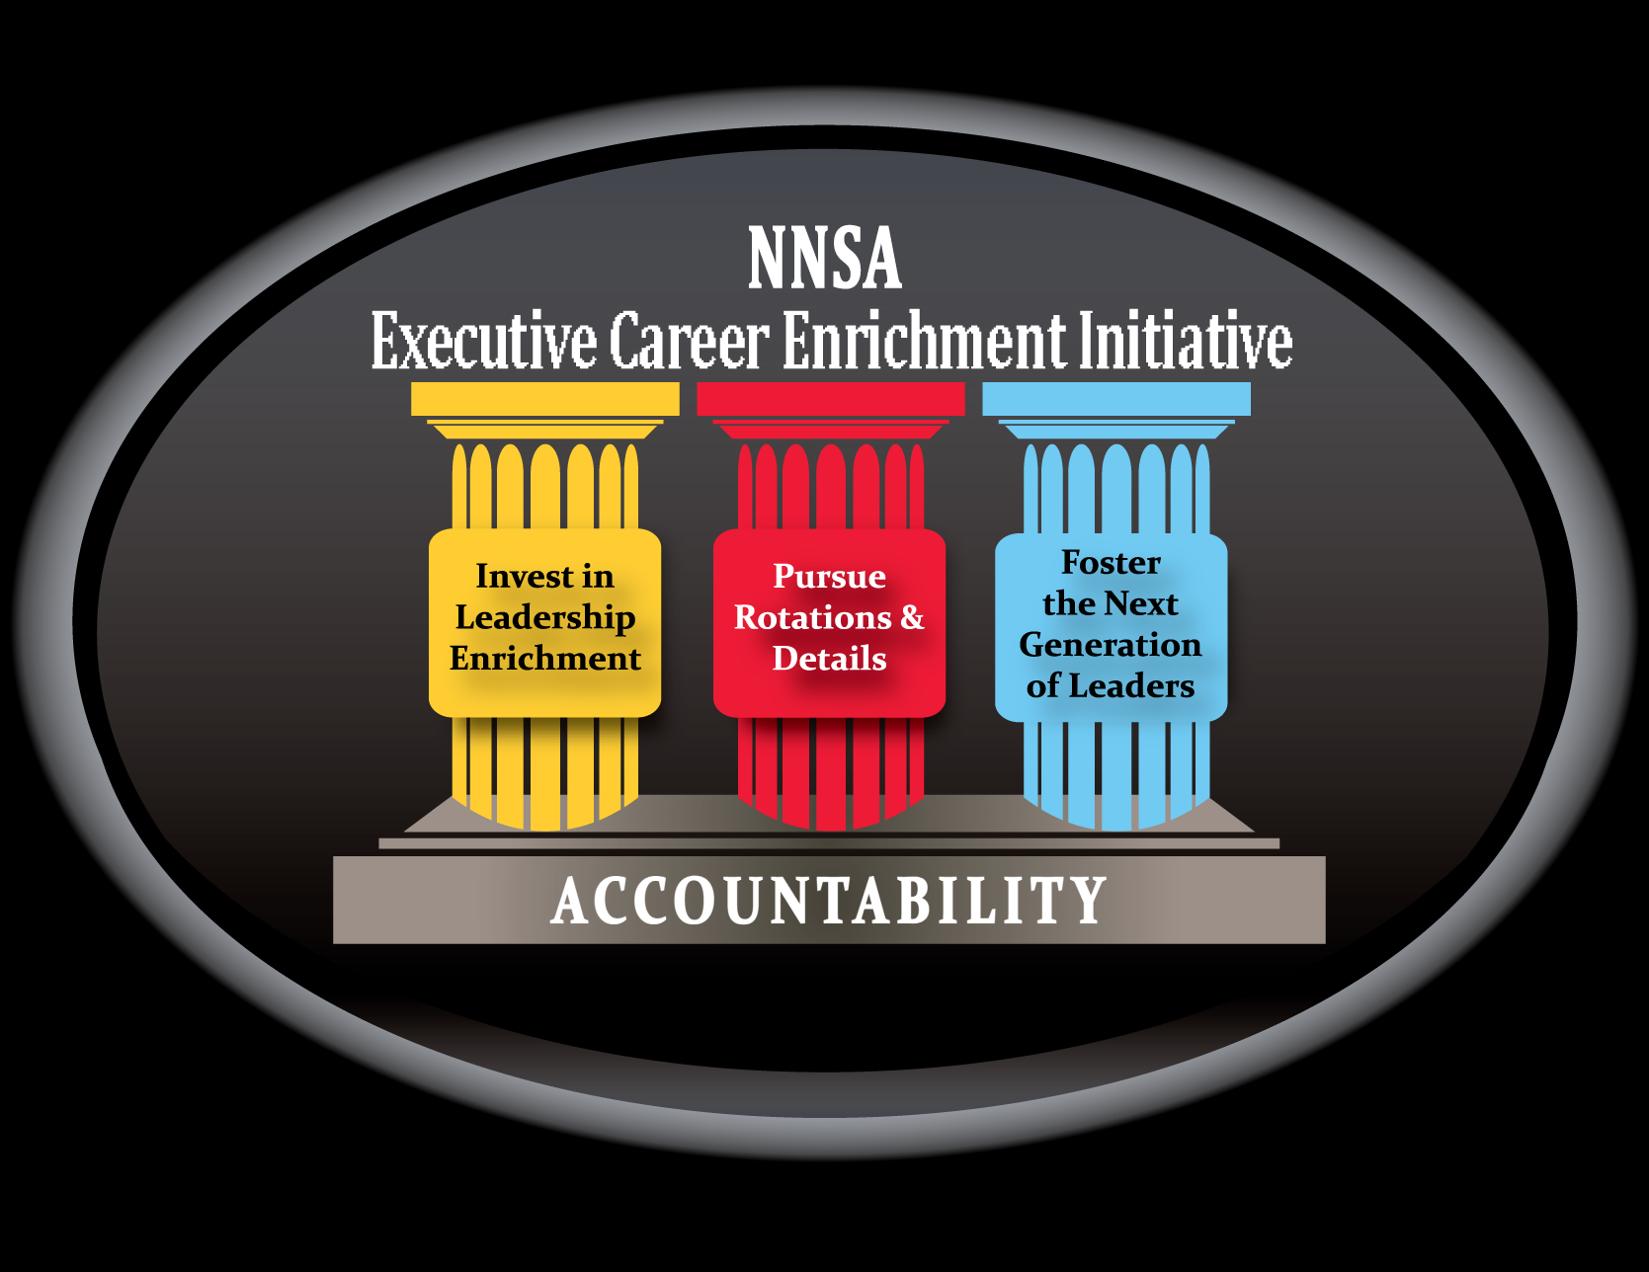
ECEI Components

Slide 6



Breakdown of ECEI Components
Invest in Leadership Enrichment
Pillar 1 - Executive Leadership Enrichment
Executive leadership training;
360 Assessments;
Tailored continued development courses or activity based on 360 results;
Executive Coaching;
Executive Development Plan (aka Individual Development Plan).
Pillar 2 – Rotations and Details
Details and assignments to HQ or Field; OR
Rotations to other government agencies; OR
Industry rotations.
Shadowing and participating in workshops to cross train and learn more about other NNSA organizations are some alternative options to the above contingent on supervisory approval.
Pillar 3 - Fostering the Next Generation of Leaders
Mentoring Program; OR
inTeach Program; and
Participate in Executive review panels for future leadership training selections.
Pursue Rotations and Details
Foster the Next Generation of Leaders
ACCOUNTABILITY: Executives and their supervisors should develop, through an Executive Development Plan, specific expectations for ECEI components utilized in a given fiscal year for inclusion in Section 6b, Leadership Attributes, of the Executive’s Performance Plan.

Slide 7



ECEI Benefits
Enhanced Mission Execution
Lead More Effectively
Develop Future Executives
Pillar 1 - Executive Leadership Enrichment
Identifies strengths for improved Mission implementation;
Builds relations and improves Executive team functioning across organization lines;
Provides thoughtful career planning opportunities;
Identifies opportunities for future growth and skill broadening; and
Provides increased opportunities for Executive networking.
Pillar 2 – Rotations and Details
Deepens understanding of agency mission;
Establishes partnerships with other organizations, agencies, and industry;
Motivates; and
Broadens experience.
Pillar 3 - Fostering the Next Generation of Leaders
Prepares the pipeline of future leaders;
Passes on knowledge; and
Provides fresh perspective on developing employees.

Slide 8
ECEI Implementation FY 2010/2011
  Executive Leadership Summit
  360 or Comparable Assessment
  Executive Coaching
  Mentoring or inTeach Program
  Pilot Industry Rotations
  Organizational Development Activities
Review, Evaluate, Assess, Make Adjustments, Maintain Implement

Slide 9
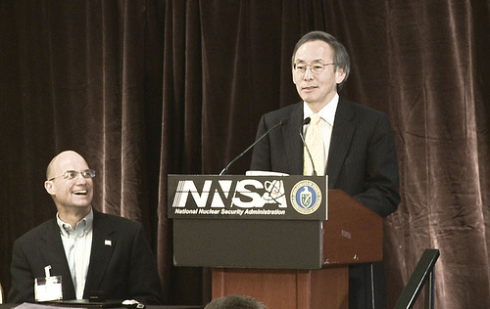
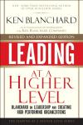
Executive Leadership Summit
Executive Leadership Summit took place April 29-30, 2010.
“Administrator’s Summit”
  Presented a complete plan to the Administrator
  Secured Administrator’s Full Engagement (2 full days)
Interactive, professionally facilitated working group sessions focused on identifying organization improvements.
Visible Support from Senior Leadership
Opportunity for Networking
Speakers - nationally known experts on leadership development.
Introduction of ECEI.

Slide 10
Pre-summit survey, who we are…
Government Service
  Civil services – 93%
  Military – 5%
  Civil Service, non career – 2%
Length of service
  1-5 years – 8%
  5-10 years – 10%
  10-15 years – 8%
  15-20 years – 7%
  20 – 30 years – 36%
  Over 30 years – 30%
Time in current position
  Less than 1 year – 0%
  1-5 years – 78%
  5-10 years – 21%
  10 years+ – 1%
  Where did you receive your first SES/PayBand V assignment?
  DOE/NNSA – 92%
  Other Federal Agency – 8%
83 respondents

Slide 11
Sample, Survey Results
As a leader of your organization,
what challenges keep you awake at night?
[The most popular responses categorized below]
Prioritizing and organizing my staff
Getting the balance right
Staff recruitment & retention
Meeting our mission
Lack of resources
Motivation
Meeting customer expectations
Ability to communicate / better communication
Develop staff to desired requirements
Better succession planning
Safety concerns

Slide 12
Professionally Facilitated Working Groups
Addressing NNSA Leadership Challenges
Achieving NNSA Cross Organizational Effectiveness
Linking Executive Leadership to Mission Execution
Top Organizational Issues and Ways to Resolve Them
Innovation

Slide 13
Mentoring/InTeach
Mentoring
Encourages Executives to transfer knowledge in order to help foster the next generation of leaders.
Currently 25% of NNSA leaders are now engaged in online mentoring.
NNSA Administrator is an active participate in NNSA ementoring program.
inTeach
Encourage Executives to teach a class in their area of expertise to transfer knowledge to other employees.
Currently NNSA has or is in the process of developing, 10 In Teach Classes.

Slide 14
360 Assessments
Since July 2010, more than 40 members of the Senior Executive Corps have volunteered to have an assessment completed.
OPM is administering the assessment and providing feedback.
Why NNSA is supporting 360 Assessments:
  Provides senior executives with feedback on specific critical leadership skills;
  Competencies are closely mapped to OPM’s Executive Core Qualifications (ECQs);
  Feedback will better inform the development of Executive Development Plans; and
  Feedback from multiple sources will allow Executive to recognize the impact of behavior on others.

Slide 15
Executive Coaching
NNSA Complex-wide Executive Coaching Contract will be finalized by September 30, 2010
Executive coaching will provide one-on-one coaching sessions to assist Executives in enhancing their unique strengths and helping them acquire the necessary competencies for success in their position by:
  Assisting Executives with interpreting the 360 degree assessment;
  Providing a safe space for open dialogue;
  Defining enrichment development goals to focus on for the year;
  Coaching the Executive in developing “measurable” goals; and
  Developing and linking goals to the Executive Core Qualifications (ECQ’s) and strengthening leadership skills.

Slide 16
FY 2011
Pilot Industry Rotational Assignments
Industry Rotations
Pilot rotations within NNSA and with industry, sending 3 NNSA Executives on a rotational assignment in FY 2011. Of note, general counsel is engaged.
To date, partnership agreements that NNSA is putting in place: Grant Thorton, the fifth largest global accounting and management consulting firm whose Global Public Sector practice has offices in Alexandria, Virginia, and representation in over 100 countries. CIGNA Insurance Company, the largest health insurance provider in America.
Benefits of Industry Rotations:
Provides Executives with alternative approaches to business and mission implementation; and
Broadens our knowledge about Corporate World operations.
Stronger partnership between government and industry;
Helps round out skillset of an Executive;

Slide 17
FY 2011
Organizational Development Activities
Unanticipated outgrowth of the NNSA Executive Summit
Completing (by first quarter 2011) a complex-wide procurement vehicle for leaders to utilize in deploying organizational development activities within their organization.
  Needs Assessment
  Focus Groups
  Leadership Development Planning
  Organizational Assessments

Slide 18
Final Thoughts
Human capital must sit at the table of leadership in order to execute an effective developmental initiative.
Ownership of an Executive program belongs with the Executive corps; human capital serves as a strategic partner.
Human capital can produce a great leadership program when different units work together and compliment one another in the design, development and deployment of a successful complex-wide program.

Slide 19
Questions?

Slide 20
Contact Information
Jeffrey Vargas
NNSA, Chief Learning Officer
Office of Human Capital Management Programs
202-586-3039
jeffrey.vargas@nnsa.doe.gov
Suzanne Carrillo
NNSA, Director Executive Resources
Office of Human Capital Management Programs
202-586-4307
Suzanne.carrillo@nnsa.doe.gov
______ _____
____ _______ ______
_______ ______ _______ _____________
_________ __ __

