Slide 1
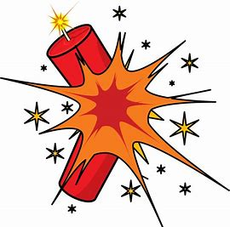

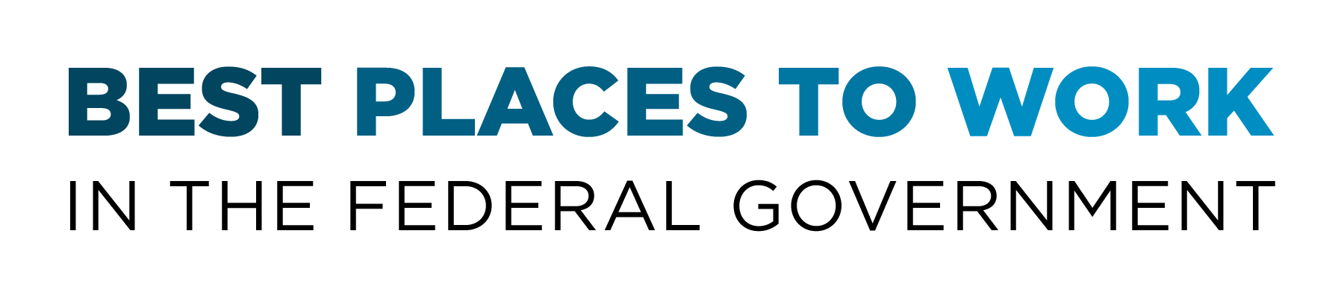
Sustaining a Dynamic Engagement and Learning Culture
Kristin McNally
Director, Office of Employee Engagement
U.S. Department of Labor
July 25, 2019

Slide 2
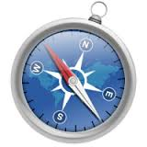
U.S. Department of Labor Profile
Vision: Helping American workers gain and hold good, safe jobs.
Mission: To foster, promote, and develop the welfare of the wage earners,
job seekers, and retirees of the United States; improve working conditions; advance opportunities for profitable employment; and assure work-related benefits and rights.
25 Agencies
14,000 Employees across the National Office and 10 Regions
21.5% of our workforce are Veterans
11.8% of our workforce are Employees with Disabilities
15.8 is the average number of years of DOL employees’ Government service
Diversity of Work Units by Agency/Region/Office/Division
2

Slide 3
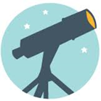

DOL Leadership Vision:
IMPROVE ENGAGEMENT
Improve leadership and managerial skills
Focus on productivity and accountability
Communicate broadly and locally
Create compelling messaging
Take action and prove value
Evaluate progress and keep going
Mission of the Office of Employee Engagement:
To cultivate a highly engaging, inclusive environment through innovation, learning,
and diversity where employees thrive and drive organizational success!
3

Slide 4
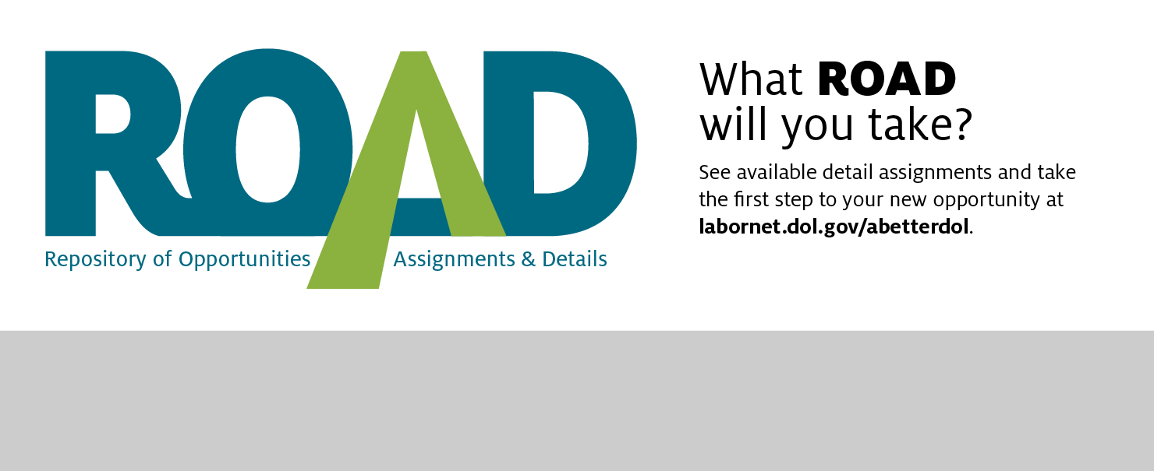
DOL’s Repository of Opportunities, Assignments & Details (ROAD) Program
25 DOL Agencies  1,340 Participants  14,300 Applications
Created in 2014 - DOL’s short-term developmental opportunities hub that increases employee engagement, career development, cross-training, and innovation
Central online repository of developmental rotational opportunities that allow employees to work temporarily on another team, within another office, or in a different DOL agency, learning new and complementary skills, for up to 120 days
Strengthens and build relationships, collaboration, and knowledge-sharing opportunities throughout the Department
Supports DOL’s mission and helps agencies gain temporary or permanent talent to meet current and future project needs - allows agencies to fill short-term skill and knowledge gaps while vacant positions are advertised
Increases the internal candidate pool for critical positions, allowing DOL to promote from within and rotate/retain employees within the Department
4

Slide 5
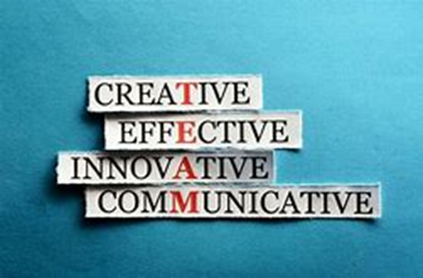
Leadership Development@Labor
In-house, subject matter expert-delivered leadership training that helps maximize productivity, shape a positive culture, and drive goal accomplishment.
Mandatory and elective course opportunities such as:
Effective Performance Management
Employee Onboarding through Separation
Leading and Managing Employees in a Collective Bargaining
Environment
Effective Engagement Strategies
Successfully Managing Telework
Understanding the DOL Budget Process
Workplace Safety and Health
L-COP: Leadership Community of Practice
Effective Use of the EAP as a Management Tool
Investigations and Audits
Benefits of Being a Balanced Manager
Notes:
Engaging leadership practices focused on fairness, trust, and accountability have helped drive results
Learning elements with current guidance and tools to help us manage challenging situations that take time away from our core missions. This program supports continuous leadership development and we are committed to delivering quality learning opportunities to support managers and supervisors.

Slide 6


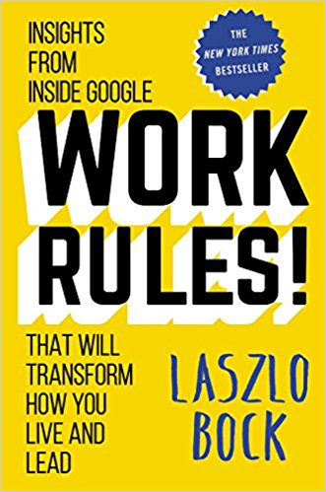
Modern Government Management Traits (MGMT)
Based on Google’s Project Oxygen and work by the
Performance Improvement Council (PIC)
The PIC ran multiple focus groups to test the face validity of Google’s results and applicability in Government, changing nothing but a few of the behaviors associated with the 8 traits. Then PIC used brain science to design the cadence of the MGMT program – 16-week program with introduction of a new trait every 2 weeks. Each 2-week cycle includes a facilitated Trait Talk and a reminder Trait Tool.
8 Management Traits (Behaviors) in Rank Order
Be a good coach
Empower; don’t micromanage
Be interested in direct reports’ success and well­being
Be productive and results-­oriented
Be a good communicator and listen to your team
Help employees with career development
Have a clear vision and strategy
Have key technical skills so you can advise your team
Notes:
PIC’s Modern Government Management Traits
The PIC ran multiple focus groups to test the face validity of Google’s results and applicability in government. We changed nothing but a few of the behaviors associated with the 8 traits. Then PIC used brain science to design the cadence of the MGMT program – 16-week program with introduction of a new trait every 2 weeks. Each 2-week cycle includes a facilitated Trait Talk and a reminder Trait Tool.
30-minute Trait Talks
These are facilitated by trained facilitators or group coaches. Each facilitator can and should customize their Trait Talk based on the work culture, audience, and their own wisdom. Read-aheads may be provided if the audience will use them. Leave behinds can be provided if participating managers will use them. But the level of investment on the part of managers should remain very, very low.
Google is widely known as an advocate of data-based decision making. So, it came as no surprise when it looked to its statisticians to help decode the secret formula to effective management.
After gathering and analyzing 10,000 manager observations including performance reviews, surveys, and nominations for top-manager awards and recognition, Google stumbled upon a realization that surprised many--even its former Senior Vice President of People Operations, Laszlo Bock.
Google’s Project Oxygen
Google is widely known as an advocate of data-based decision making. So, it came as no surprise when it looked to its statisticians to help decode the secret formula to effective management.
After gathering and analyzing 10,000 manager observations including performance reviews, surveys, and nominations for top-manager awards and recognition, Google stumbled upon a realization that surprised many--even its former senior vice president of people operations, Laszlo Bock.

Slide 7
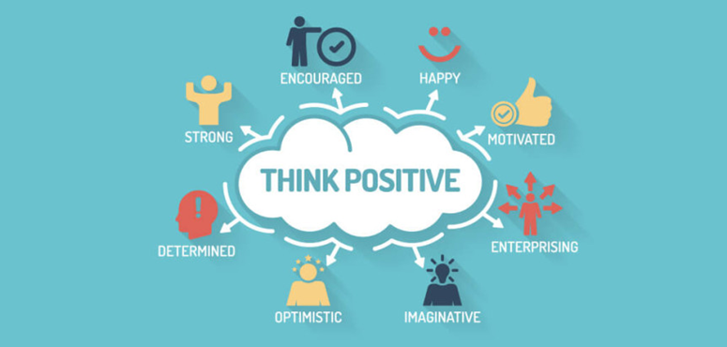
Mentoring@Labor
Promotes employee engagement, career counseling, and development in line with DOL's goals to improve employee networking, information sharing, and organizational performance.
Organizational Benefits of Mentoring:
Builds bench strength
Enhances employee performance
Improves retention
Mentoring Action Plan:
Accountability for competency development, goal planning/accomplishment, resource identification, timelines
Notes:
Newly launched DOL-wide program to promote the power of mentoring relationships and collaboration

Slide 8
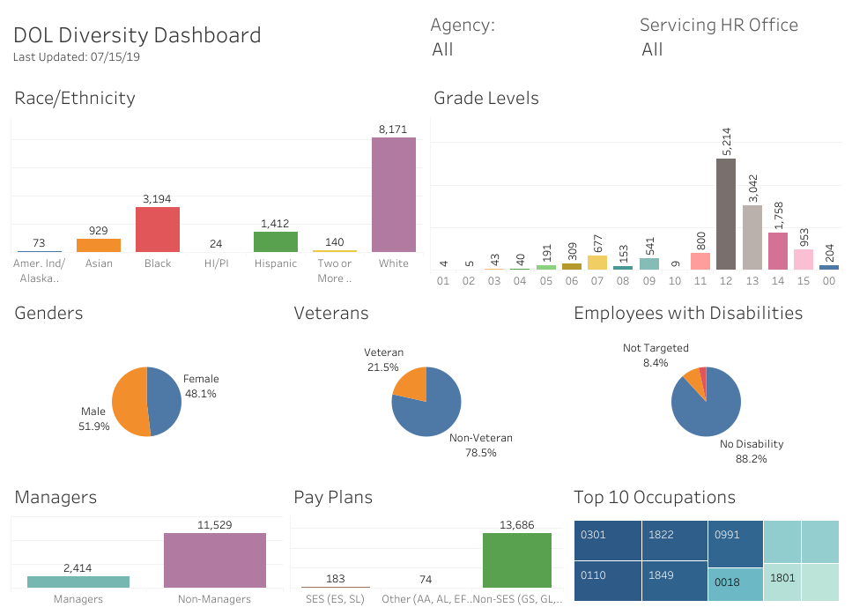
Diversity Data Dashboard
Interactive tool available to all employees that provides current demographic data and employee statistics to drive better understanding and use of diversity metrics.

Slide 9

Employee Engagement Action Planning
Goals
Build upon successes of past Departmental/Agency engagement efforts and FEVS focus areas - Leadership, Training, Innovation - to create a comprehensive yet streamlined Performance Culture Index (15 questions) to simplify data tracking and action planning
Evolve DOL’s engagement strategy to reflect Government reform imperatives; and align with OPM’s and DOL’s Human Capital strategic and operational plans, DOL leadership priorities, and the President’s Management Agenda (PMA)
Promote shared responsibility and continued traction for engagement across DOL
Hold Agencies, leaders, and employees accountable for improved individual and organizational performance
Outcomes
Increased ownership and accountability for progress
Better strategic and operational alignment
Stronger relationships with employees, engagement
SMEs, Affinity Groups, and Unions across DOL
More effective communications related to FEVS and beyond

Slide 10
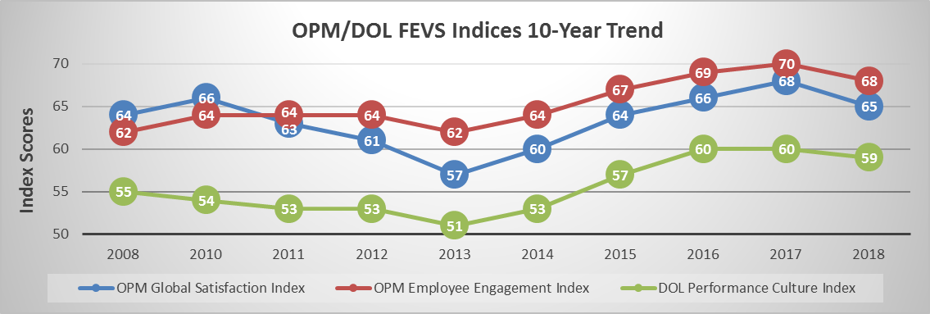
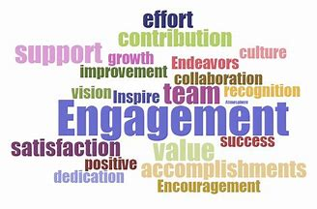
DOL’s FEVS Trends
10

Slide 11
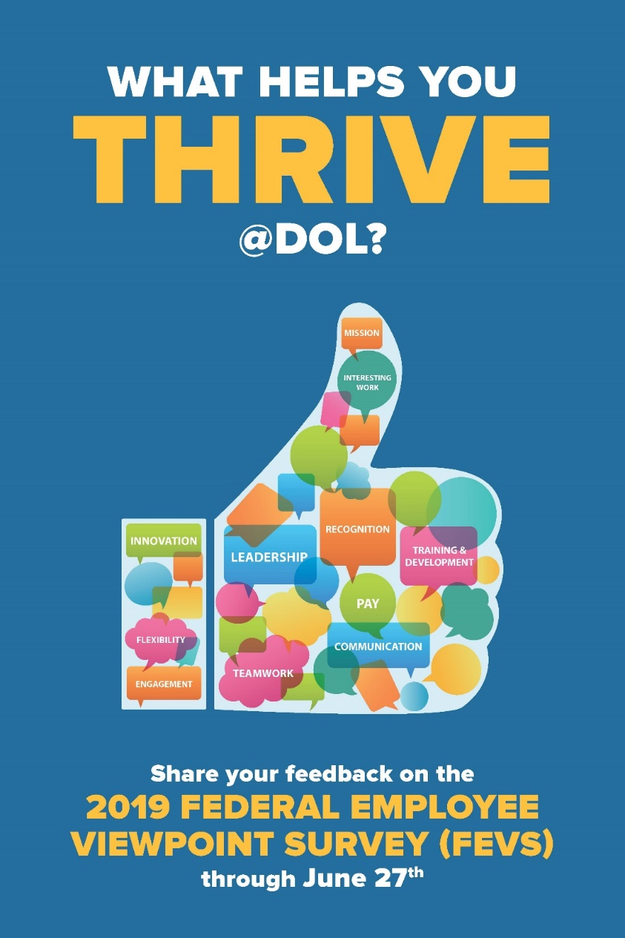
FEVS Communications
FEVS Community of Practice – Quarterly meetings and regular communications
Agency FEVS Results, Action Plans, and tools on LaborNet (intranet)
Focus on strategic, positive, visual communications that echo employee input
Local implementation of effective communication strategies
Coaching-style communications to leaders, managers, employees – Tip Sheets and just in time information

Slide 12

For More Information
Please Contact:
Kristin McNally
Director, Office of Employee Engagement
U.S. Department of Labor
McNally.Kristin.N@dol.gov
(202)693-7649

